Slide 1
Navajo Nation
Requisitioners/Receivers– Procurement & Sourcing
PRESENTED TO
Navajo Nation
PRESENTED BY
Andrea Garay
DATE
May 5-7, 2026

Slide 2

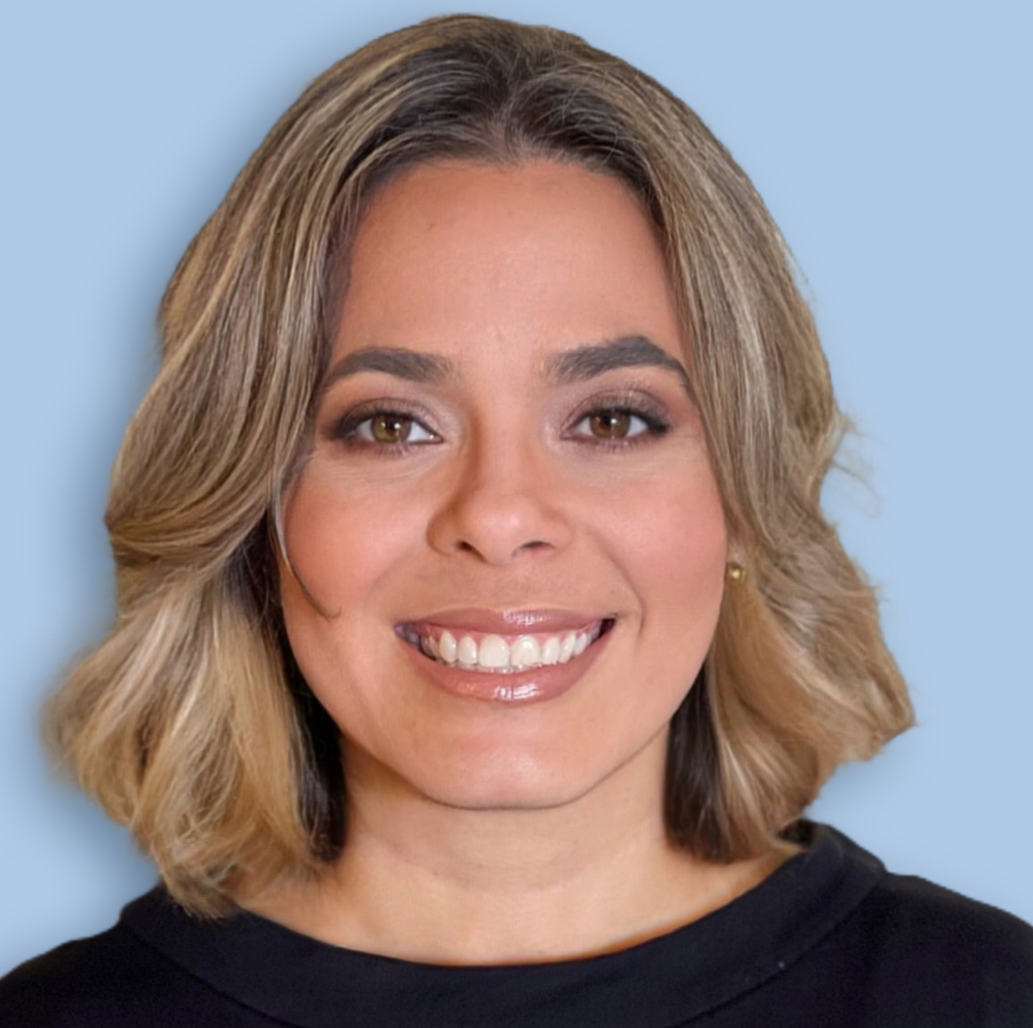
About me …
Andrea Garay
Solution Consultant
20+ years of experience with Microsoft Dynamics products; nearly 5 years with Arctic IT supporting D365 FSCM projects.
Accounting background → I started as a system user before moving into consulting in 2008.
Mom of 4 boys → which makes me an expert at multitasking, troubleshooting, and refereeing 😊.

Slide 3
Why do you think you were chosen to be part of this training?

Slide 4

Why You Were Selected
You understand your Division’s processes and needs
You are trusted by your leadership and peers
You are key to supporting your team through this transition
You will play a critical role in the success of this system

Slide 5
Session Objectives
Understand the end-to-end Procurement process in D365 FSCM
Gain hands-on experience to confidently perform daily tasks
Prepare Power Users to train their Division teams
Align on expectations for Division training rollout and support
Build confidence to support users during and after Go-Live

Slide 6
Training Session Strategy
How we will learn:
I will introduce the concepts first.
I will demo the process → please watch closely.
You will then complete the steps yourself using a practice sheet.
Important: Watch the demo first, ask questions, then practice.
Learn → Watch → Do

Slide 7
Training Ground Rules
We move together—please do not click ahead so everyone stays aligned
This is a hands-on session, so active participation is expected
Focus on understanding the process, not just the steps
Budget errors must be resolved before submission
Transactions over $10K will be reviewed in a separate session
This training reflects the approved process as designed
👉This is not the time to redesign the process—
we are here to execute and learn the approved solution.
Learn → Watch → Do

Slide 8
Basics
Notes:
QRG2

Slide 9
F&SCM Chart of Accounts Structure – QRG2
FMIS
Company | Business Unit | Object Account | Subsidiary
8340 FHWA-NDOT FY23 PA-RFA | K231014 N609 Tuba City ‘23 | 4130 Office Supplies
10 General Fund | 102002 Chinle Judicial District | 3250 Lodging
F&SCM
Main Account (4 chars) | Department (3 chars) | Award (8 chars) | Project (5 chars) | Location (6 chars) | Fund (1 char) | Division (3 chars)
6000 Office Supplies | 307 DEPT OF ROADS - GF | 20205011 20205;693JG42330000V600AZ0028 | 00000 | 000000 Not Location specific | 2 External Fund | 321 DIVISION OF TRANSPORTATION
5110 Personal Travel Expenses | 171 JUDICIAL DISTRICT COURTS | NN100000 General Fund | 00000 Not Project specific | 122014 Chinle | 1 General Fund | 202 Judicial Branch
Notes:
The Navajo Nation’s existing FMIS chart of accounts differs both structurally and functionally from that of F&SCM. The objective of this design is to ensure a seamless, consistent, and auditable transition to the new chart of accounts, aligning with F&SCM best practices and enabling efficient financial reporting and querying in the new system.

Slide 10
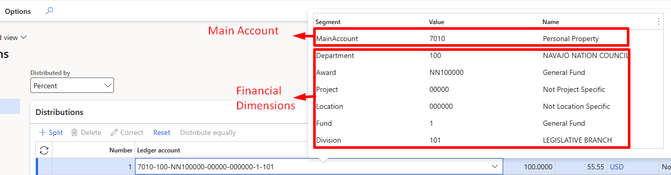
How Posting Works in D365 F&SCM
D365 requires a full account string for every transaction to post to the ledger.
  A full account string = Main Account + Financial Dimensions.
Where the pieces come from:
  Main Account → comes from the Procurement category.
  Financial Dimensions → usually manually entered.

Slide 11
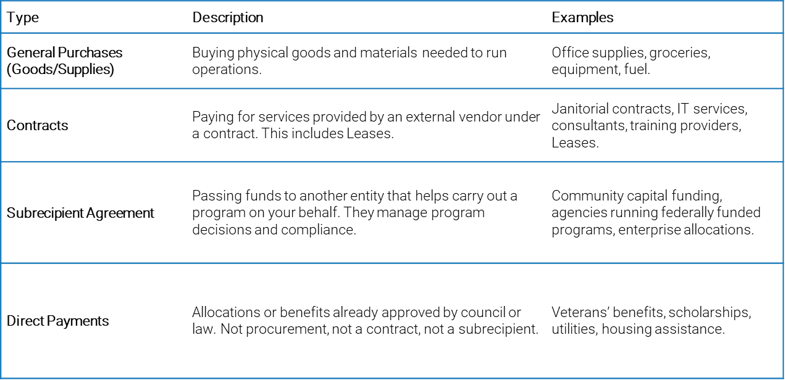
Business Reason
The Business Reason provides justification for the purchase and ensures compliance with policy.
Most importantly, the business reason determines which approval workflow process the requisition follows.
Without a valid business reason, the requisition cannot be submitted for approval.

Slide 12
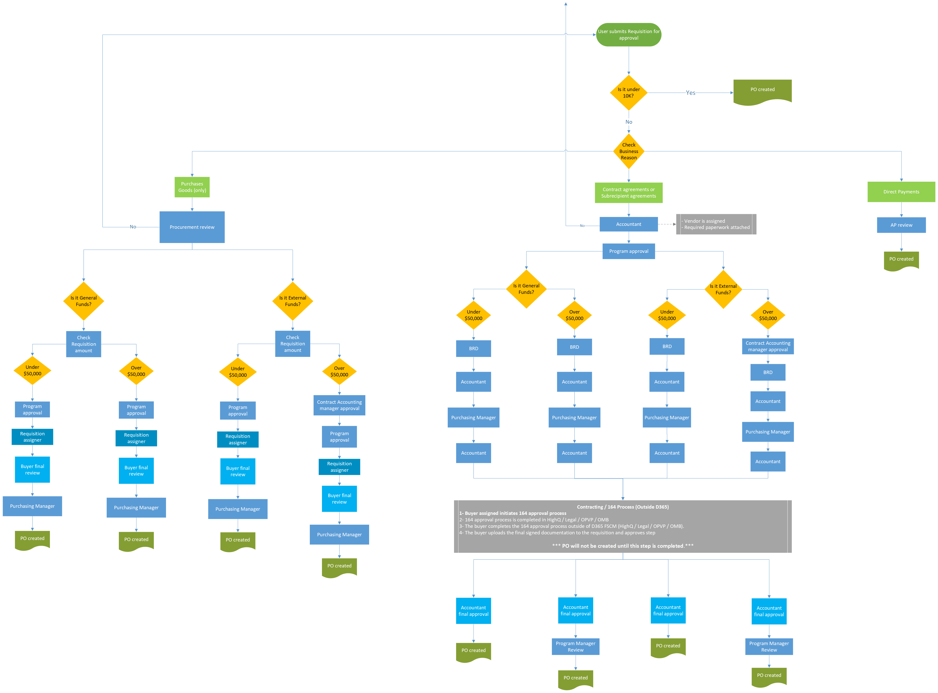
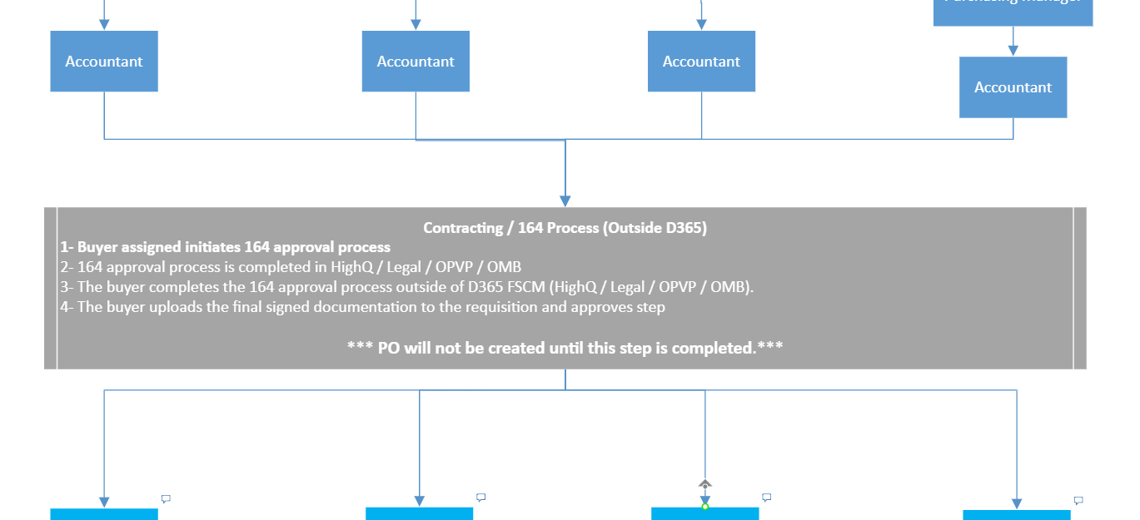
Purchase Requisition workflow
164 Process (Outside of D365 F&SCM)

Slide 13
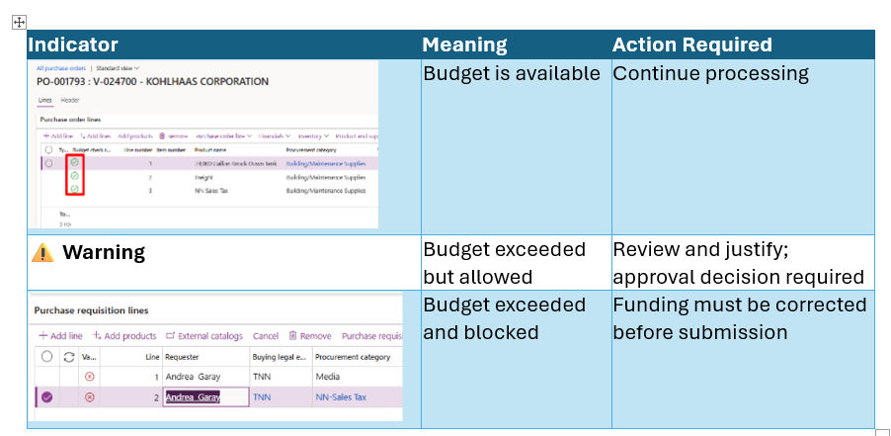
Understanding Budget Control and Purchase Requisitions
The following financial dimensions are used for budget control:
  Department
  Award
  Project

Slide 14
Let’s Get to Work!

Slide 15

Personalize your space
Logging in D365 FSCM
Creating Favorites in D365 F&SCM
Personalize Purchase Requisitions form
Enable Workflow Notifications

Slide 16
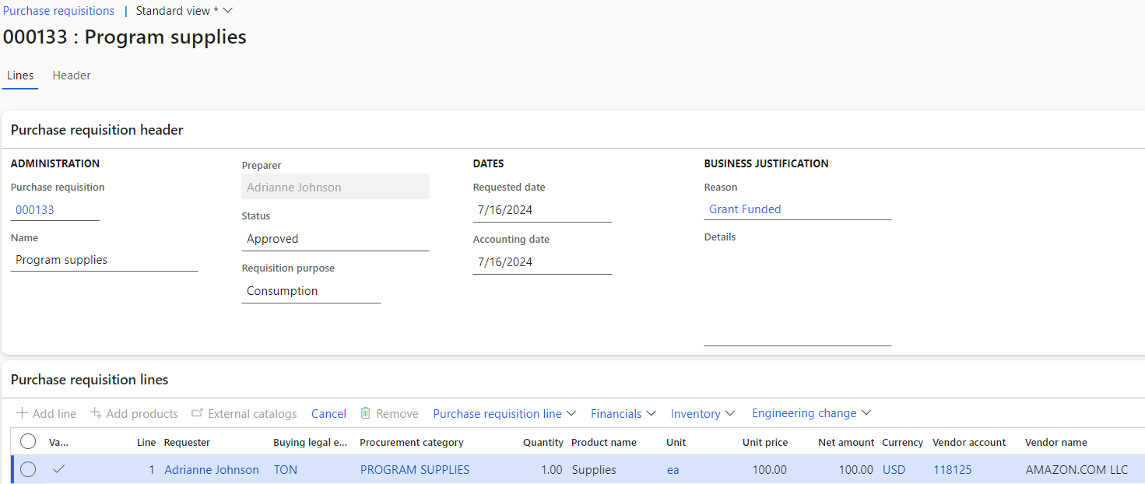
Purchase Requisitions
A purchase requisition is an internal document that authorizes the Purchasing department to buy items or services.
After a purchase requisition is approved via workflow, it will generate a purchase order.
Notes:
Continue next slide …

Slide 17
SCENARIO 1 – Office Supplies Under $10K (Full Receipt)
Business Case:
  Purchase $8,500 in office supplies using General Funds.
Flow:
  Create requisition
  Enter dimensions
  Enter attachments
  Submit workflow
  PO auto-creates
  Open PO
  Assign buyer
  Confirm PO
  **Full receipt**
Notes:
Key Teaching Points:
PO remains Open after partial receipt
Remaining quantity stays available
Receiving controls status progression
Optional if time:
Reverse product receipt
Show how status resets

Slide 18
List of users by department
User | Department
Brenda Holgate | 770
Brenda Tsosie | N/A
Charlene Jim | 846
Chassidy Logg | N/A
Cheyenne Livingston | N/A
Cynthia Avery | N/A
Darlene Begay | 610
Delores Hunt | 846
Evangelene Shorty | N/A
Jeremy Gishey | 880
Larieta Tso | N/A
Lisa Tsosie | 998
Marcus Yazzie | 610
Minja Taliman | 610
Pricilla Greyeyes | 770
Richard Gomez Jr. | 998
Robert Allan | 770
Shara Peterson | N/A
Sherelle Walker | 998
Shirlene Johnson | 846
Valentina Redhorse | 880
User | Department
Alisha Davis | 500
Carletta Chevarillo | 580
Clarinda Begay | 100
Danista Golden | 550
Davina Begaye | 100
Dominic Beyal | N/A
Hanasbah Wyaco | N/A
Jerrilyn Owens | 300
Julia Mitchell | 500
Kristina Silversmith | 580
Leonard Francisco Jr. | 550
Marsha Johns | N/A
Monica Ayze-Roanhorse | N/A
Norbert Nez | 300
Patrick Yazzie | 550
Sharen Sandoval | 113
Shayla Yellowhair | 500
Stephen Etsitty | 580
Tia Yazzie | 300
User | Department
Almeria Slinkey | 170
Cassandra Little | 170
Cecelia Thomas | 170
Cinandre Dolfin | 170
Edith Snyder | 700
Eunice Harrison-Martin | N/A
Harmon Mason | 170
James Bennet | N/A
Kendra Watchman | 170
Letisha Tom | 700
Linda Williams | 170
Lorraine Tabaha | 700
Melanie Price | 170
Paulette Begay | 170
Raquel Chee | 170
Robert Willie | 270
Sandra Dalgai | 170
Shani Francis | N/A
Stacey Chester | 660
Tanya Shepard | 660
Vanessa Mescal | 170

Slide 19
SCENARIO 2 – Blanket Order Under $10K (Partial Receipt)
Business Case:
Create a $9,000 blanket order for supplies delivered monthly. Add NN Sales tax.
Flow:
  Create requisition under $10K
  Submit → PO auto-creates
  Confirm PO
  **Receive partial quantity**
  Review PO status
Notes:
Instructor Steps
Demo creation
Submit workflow
Show “In Review” status
Show Workflow History
Participants:
Create requisition
Submit
Review workflow history
Explain:
These will be approved tomorrow
This simulates real process

Slide 20
SCENARIO 3 – Order Over $10K (Approval Route)
Business Scenario
  Your program needs to purchase $18,500 in equipment.
Work Steps
  Create requisition
  Enter dimensions
  Enter attachments
  **Enter a discount**
  Submit workflow
  Review Workflow History
  Leave in “In Review”
Notes:
Instructor Steps
Demo creation
Submit workflow
Show “In Review” status
Show Workflow History
Participants:
Create requisition
Submit
Review workflow history
Explain:
These will be approved tomorrow
This simulates real process

Slide 21
SCENARIO 4 – Contract Over $10K (Approval Route)
Business Case:
  Create $12,000 service contract (General Funds – Award NN000010).
Flow:
  Create requisition
  Select Business Reason: Service Contract
  Enter attachments
  Submit workflow
  Review routing
  Review Workflow History
  Leave in “In Review”
Notes:
Explain:
Contract approval path differs
External funds may require contract accounting
May require RFQ outside system
Teaching Points:
Business reason drives workflow
External vs General funds
Over $50K additional approvals

Slide 22
SCENARIO 5 – Contract Over $10K – No budget available
Business Case:
  Create $15,000 service contract (External Funds – Award AZ000058).
Flow:
  Create requisition
  Select Business Reason: Service Contract
  Enter attachments
  Budget control statistics
  Change Distributions
  Submit workflow
  Review routing
Notes:
Explain:
Contract approval path differs
External funds may require contract accounting
May require RFQ outside system
Teaching Points:
Business reason drives workflow
External vs General funds
Over $50K additional approvals

Slide 23
Purchase Orders - Additional Scenarios
Reverse a Purchase Order Receipt (QRG 10)
Cancel remaining quantities (QRG 7)
Finalize a Purchase Order (QRG 13)
Adjustments to Purchase Orders

Slide 24
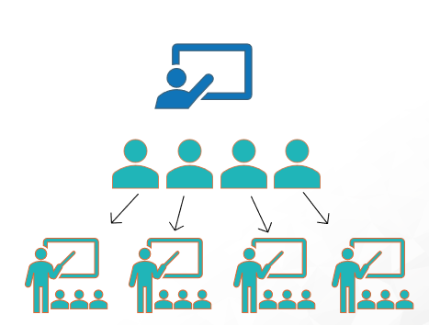
Post-Training Rollout Plan
Phase 1 – Core Training (May 5–7)
  Power Users trained onsite
  Hands-on system exposure
  End-to-end lifecycle practice
Phase 2 – Remote Preparation (May 11-22)
  (May 11- 22) Practice using the QRGs and practice Sheet
  (May 25 – 29) Working sessions between AIT and Power Users
    Focus:
      Reinforce system knowledge
      Prepare for training delivery
      Review materials and scenarios
      Align on rollout expectations

Slide 25
Post-Training Rollout Plan
Phase 3 – Division Rollout Execution (TBD)
  Each Division will lead their own internal training using the same model.
Recommended Approach (may vary by Division):
  3-day training cycles per Division
  Up to 20 users per session
  Option to run up to 2 sessions per day

Slide 26
ADDITIONAL TOPICS
Data refresh
Practice Sheets and QRG location
Make sure to disconnect from the Wifi

Slide 27
Andrea Garay
agaray@arcticit.com
Natalie Ruela
nruela@arcticit.com

Slide 28
FINAL CHALLENGE - Full Cycle Under $10K
No step-by-step instruction — using only the QRG.
Give this:
  Create a requisition under $10K,
  Submit,
  Locate the PO and confirm it,
  Receive it fully

Slide 29
Questions?

Slide 30
Thank You!

