Slide 1
Navajo Nation
Approvers– Procurement & Sourcing
PRESENTED TO
Navajo Nation
PRESENTED BY
Andrea Garay
DATE
May 5-7, 2026

Slide 2
Session Objectives
By the end of this session, participants will be able to:
Open requisitions from notifications
Review requisition details
Check budget control indicators
Review attachments
Approve / Request change / Reject
View workflow history
Learn → Watch → Do

Slide 3
Training Expectations
Your role is approving requisitions submitted by your program staff
Focus is how to perform approvals in the system
Internal policies are handled by each Division
This training reflects the process as designed and approved.

Slide 4
Basics
Notes:
QRG2

Slide 5
F&SCM Chart of Accounts Structure – QRG2
FMIS
Company | Business Unit | Object Account | Subsidiary
8340 FHWA-NDOT FY23 PA-RFA | K231014 N609 Tuba City ‘23 | 4130 Office Supplies
10 General Fund | 102002 Chinle Judicial District | 3250 Lodging
F&SCM
Main Account (4 chars) | Department (3 chars) | Award (8 chars) | Project (5 chars) | Location (6 chars) | Fund (1 char) | Division (3 chars)
6000 Office Supplies | 307 DEPT OF ROADS - GF | 20205011 20205;693JG42330000V600AZ0028 | 00000 | 000000 Not Location specific | 2 External Fund | 321 DIVISION OF TRANSPORTATION
5110 Personal Travel Expenses | 171 JUDICIAL DISTRICT COURTS | NN100000 General Fund | 00000 Not Project specific | 122014 Chinle | 1 General Fund | 202 Judicial Branch
Notes:
The Navajo Nation’s existing FMIS chart of accounts differs both structurally and functionally from that of F&SCM. The objective of this design is to ensure a seamless, consistent, and auditable transition to the new chart of accounts, aligning with F&SCM best practices and enabling efficient financial reporting and querying in the new system.

Slide 6
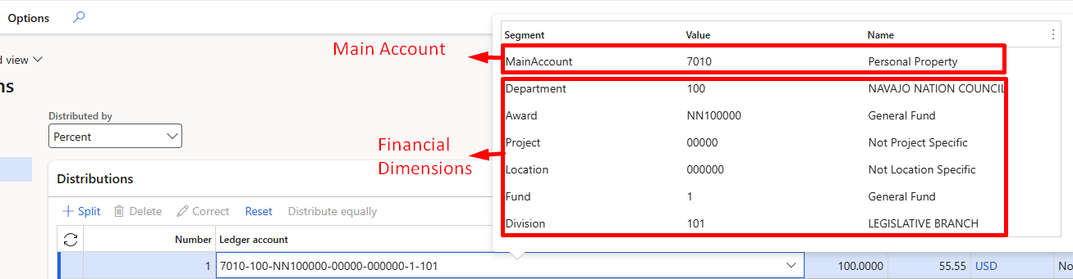
How Posting Works in D365 F&SCM
D365 requires a full account string for every transaction to post to the ledger.
  A full account string = Main Account + Financial Dimensions.
Where the pieces come from:
  Main Account → comes from the Procurement category.
  Financial Dimensions → usually manually entered.

Slide 7
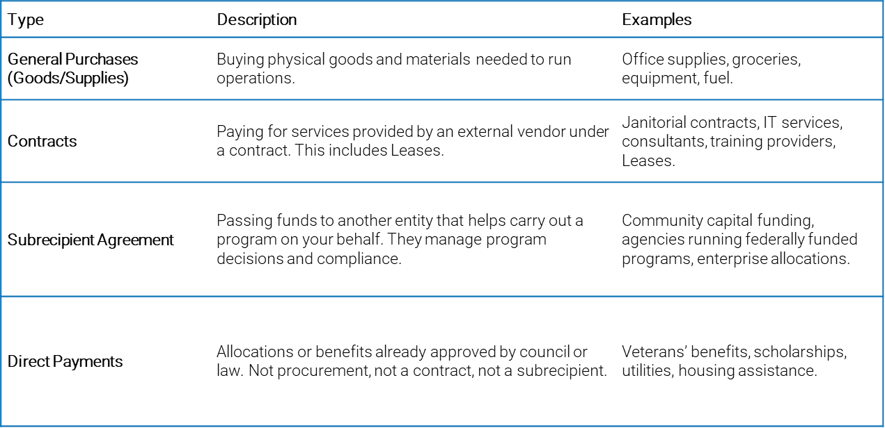
Business Reason
The Business Reason provides justification for the purchase and ensures compliance with policy.
Most importantly, the business reason determines which approval workflow process the requisition follows.
Without a valid business reason, the requisition cannot be submitted for approval.

Slide 8
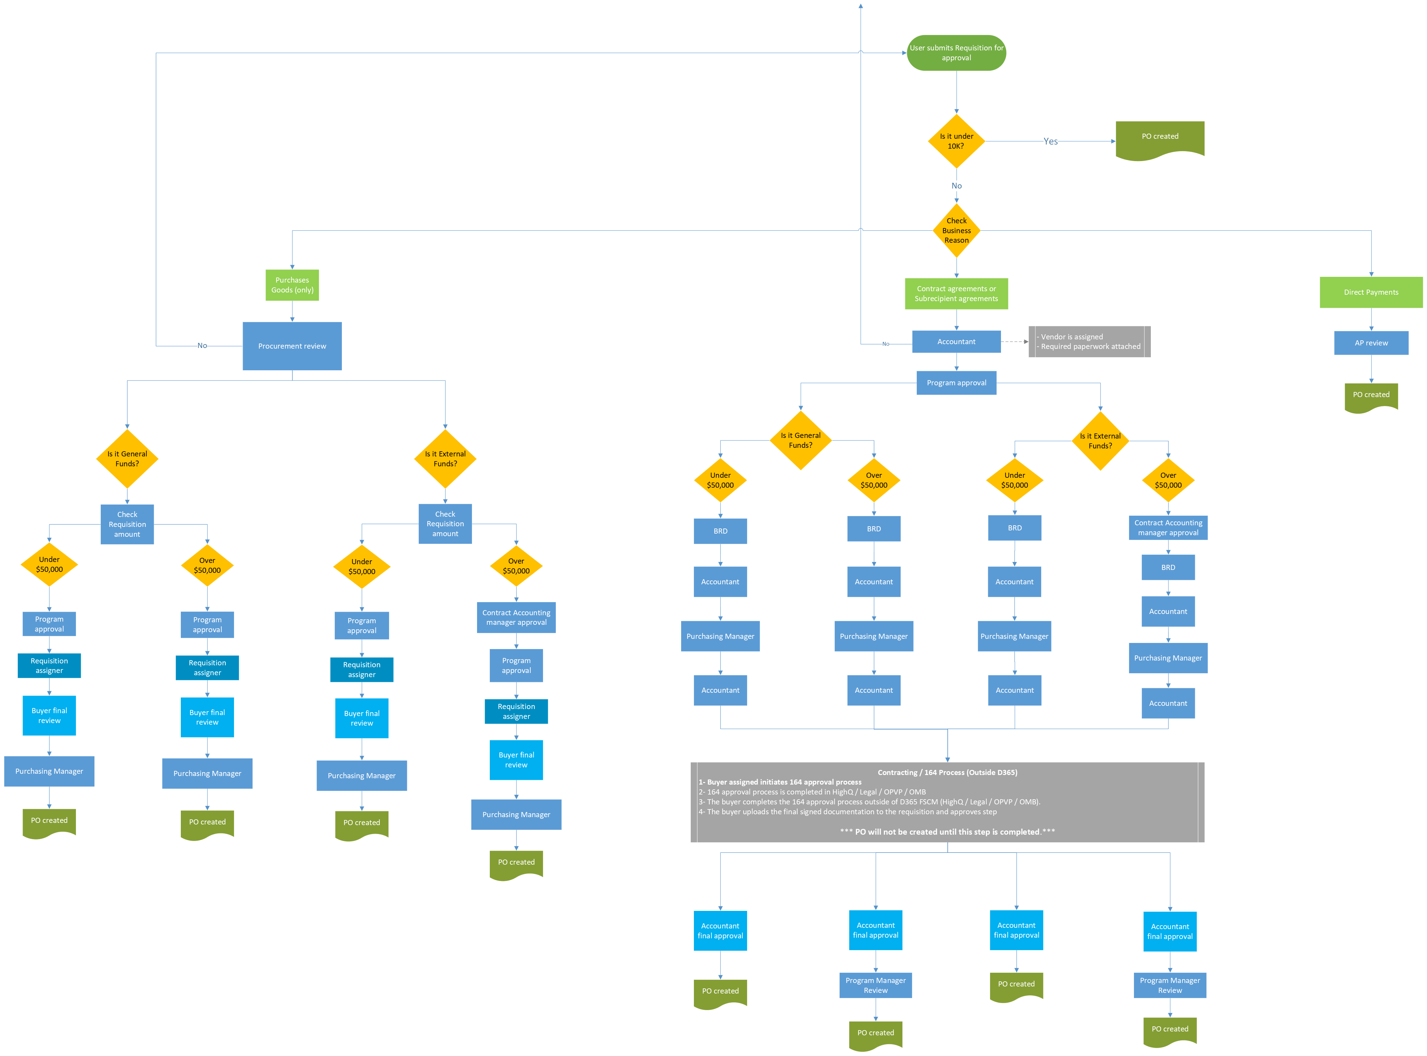
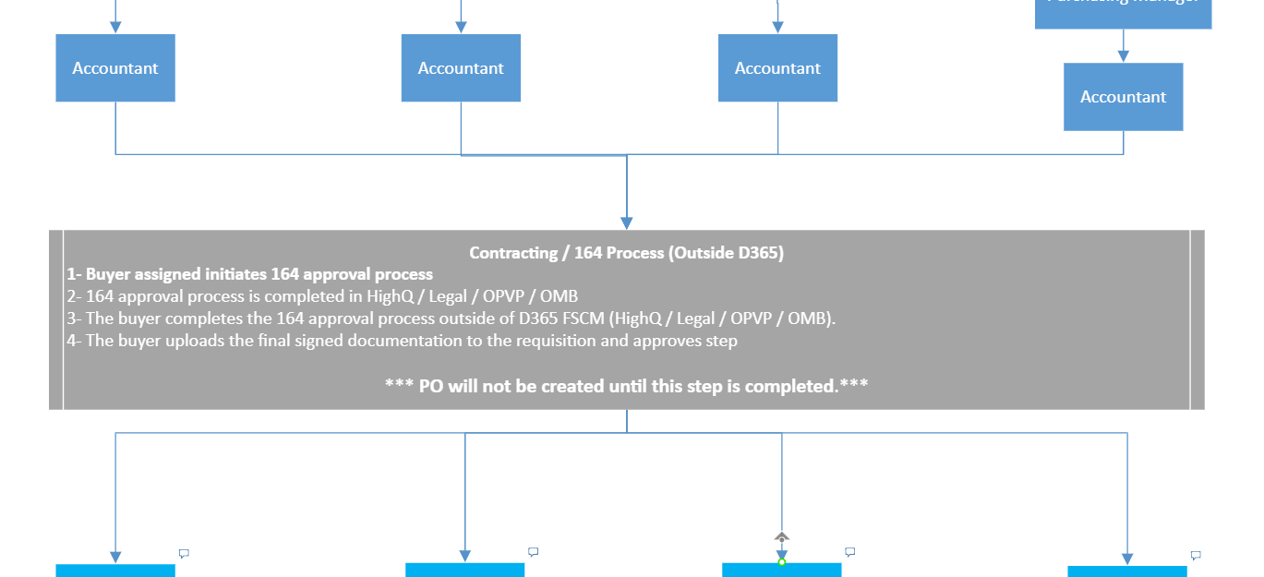
Purchase Requisition workflow
164 Process (Outside of D365 F&SCM)

Slide 9
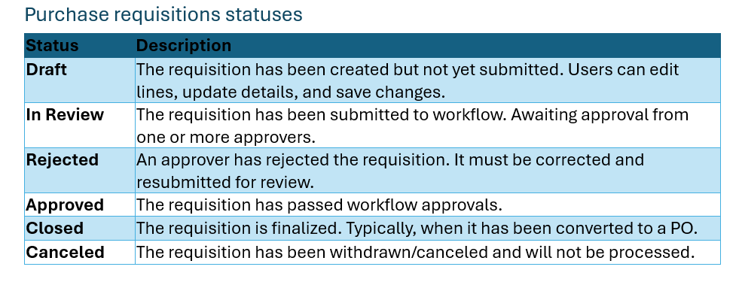
Purchase Requisition workflow

Slide 10
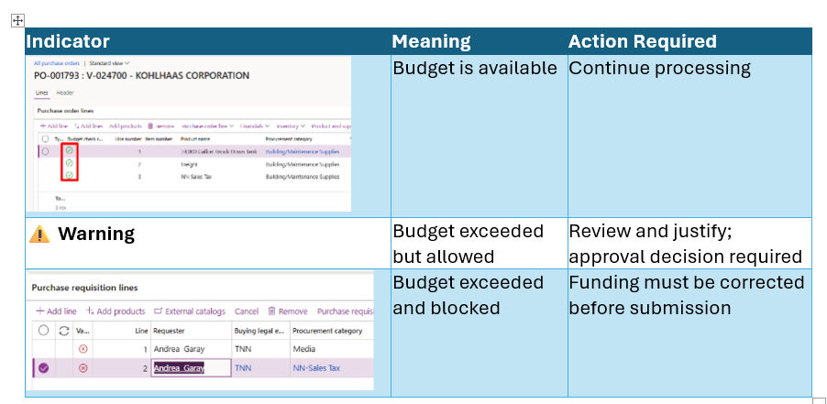
Understanding Budget Control and Purchase Requisitions
The following financial dimensions are used for budget control:
  Department
  Award
  Project

Slide 11
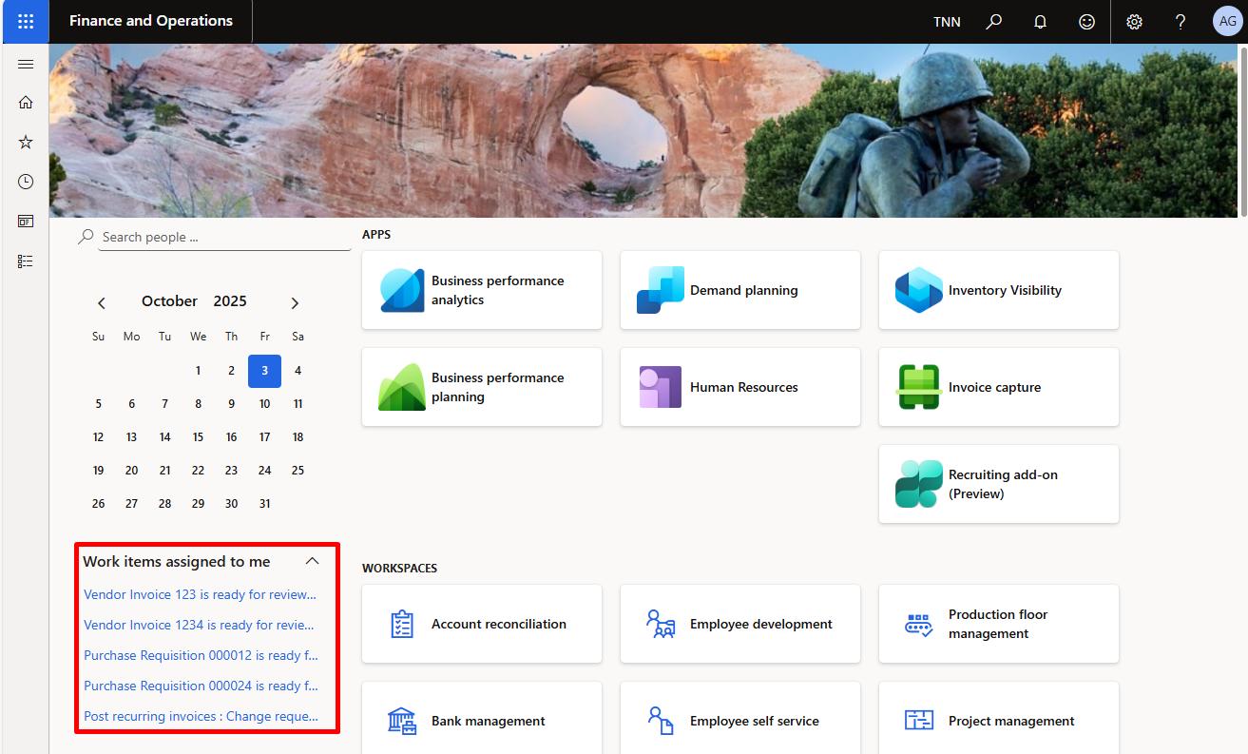
Purchase Requisitions notifications
When a requisition is submitted for approval, you will be notified in three places:
Action Center – if enabled for your user (see instructions below), notifications appear in the top right of the screen.
Work items assigned to me – on your D365 home page, showing pending tasks.
Emails – based on email configuration.
Notes:
Continue next slide …

Slide 12
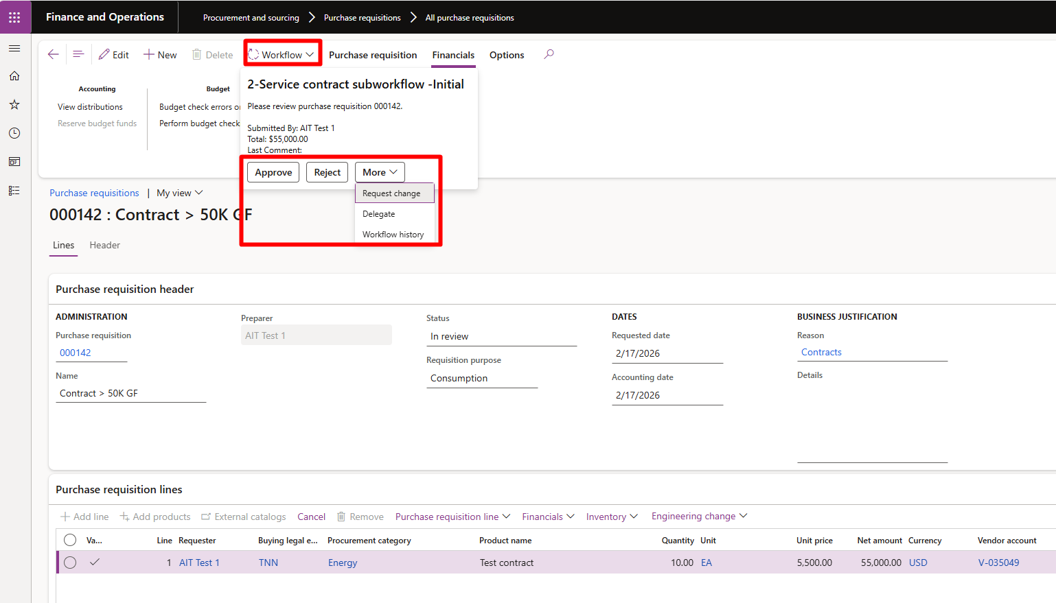
Purchase Requisitions approvals
Procurement and sourcing → Purchase requisitions → Purchase requisitions requiring my action
  Review requisition lines
  Review amounts
  Check budget control
  Review attachments
  Take workflow action
Notes:
Continue next slide …

Slide 13
Hands-On Exercise
Scenario:
  A requisition has been submitted to you for approval.
Tasks:
Open requisition from Work items assigned to me
Review requisition lines
Check budget control
Review attachments
Approve the requisition

Slide 14
Optional Extra (If Time Allows)
Add to your Favorites:
Purchase requisitions prepared by me
Purchase requisitions requiring my action

Slide 15
Questions?

Slide 16
Thank You!

