Slide 1
Navajo Nation
Train The Trainer – Procurement & Sourcing
PRESENTED TO
Navajo Nation
PRESENTED BY
Andrea Garay
DATE
October 15-16, 2025

Slide 2

Agenda
Introductions & expectations
Basic Navigation
Procurement & Sourcing Overview
Purchase Requisitions
Procurement functions
Purchase Requisition Approvals
Purchase Orders
Product Receipts
Inquiries & Reports
Wrap-up/Q&A
  Action items & parking lot items
Next steps

Slide 3


About me …
Andrea Garay
Solution Consultant
20+ years of experience with Microsoft Dynamics products; nearly 5 years with Arctic IT supporting D365 FSCM projects.
Accounting background → I started as a system user before moving into consulting in 2008.
Mom of 4 boys → which makes me an expert at multitasking, troubleshooting, and refereeing 😊.

Slide 4
💬 Let's hear about you
Please share:
👤 Your name,
💼Your role,
🎉 A ‘hidden skill’ you use at work.

Slide 5
Training Strategy
Train-the-Trainer (TTT)
  AIT Trainers teach NN Power Users
  NN Power Users teach NN End Users (internal and external)
Power User Training
  Coordinated by AIT and NN
  AIT led
  Remote and onsite
  QRGs with system processes
End User Training
  Coordinated by NN
  NN Power user led
  Onsite
  QRGs with system and business processes

Slide 6
Keys to Success
Power User Training
Start planning as a team
Talk through your questions and concerns
Approach learning as if you are going to be the teacher
Keep UAT in mind – document key business processes

Slide 7
Training Session Strategy
How we will learn:
I will introduce the concepts first.
I will demo the process → please watch closely.
You will then complete the steps yourself using a practice sheet.
Important: Watch the demo first, ask questions, then practice.
Learn → Watch → Do

Slide 8
Training Ground Rules
This training reflects the process as designed and approved.
This is not the time to change processes or training materials.
We will use a Parking Lot to capture questions or change requests.
  Items will be discussed at the end (if time allows) or in follow-ups.
Focus now is on learning the system — next step is UAT (User Acceptance Testing).
  You will be considered Power Users and will train others.
As we go, please note test cases to include during UAT.

Slide 9
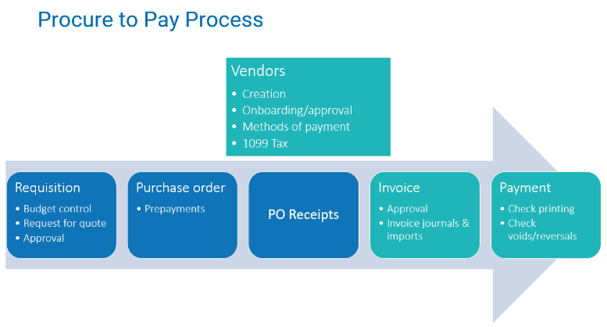

Slide 10
Basic Navigation & Personalization
Notes:
QRG2

Slide 11
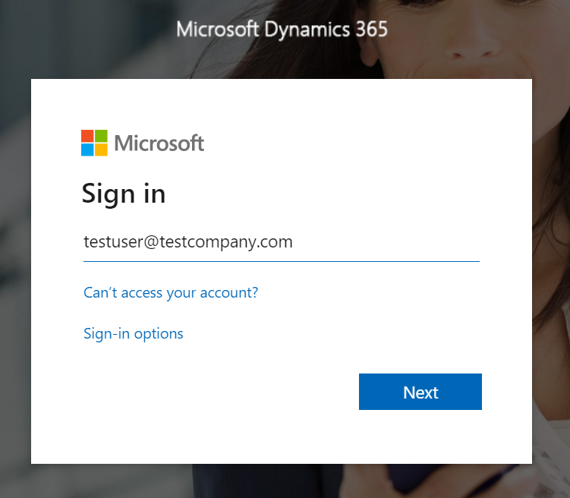
D365 Finance & Operations
Logging In
D365 F&O is a web-based software accessed through an internet browser (like Google Chrome, Microsoft Edge).
Login is your Office 365 credentials (same as your login for your Outlook email).
Notes:
Notes:
Remind users that because this is a web-based environment so they must have internet connection to access it.

Slide 12
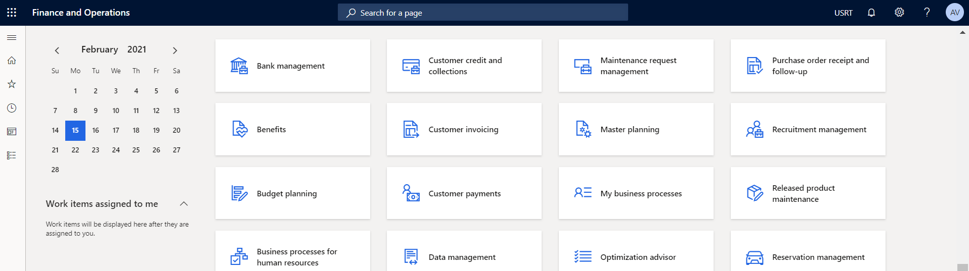
Basic Navigation – QRG1
Home Screen 101
1
2
3
4
5
6
7
1
Home Button: Click ‘Finance and Operations” in the upper left to return Home.
3
Company Selector: For organizations with multiple business units use this area to select a business unit to work in.
5
Settings:
Adjust personal settings with the gear icon.
7
Hamburger menu icon:
Click to 3 lines icon to expand or collapse the Navigation pane.
2
Navigation Search:
Search across F&SCM for a certain page.
4
Alert Center:
Notifications and alerts are displayed under this bell icon.
6
Log Out:
Log out with the circle icon with your initials in the upper right corner.
Notes:
Read and show D365

Slide 13
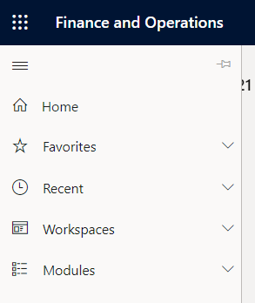
Basic Navigation
Navigation pane
Hamburger menu icon: Expand or Collapse the Navigation pane
1
1
7
2
Home: Return to the Home Screen (or click the words “Finance and Operations” at the top)
2
3
Favorites: Access favorite “starred” pages in the system quickly
3
4
Recent: Displays the 10 most recently accessed pages
4
5
Workspaces: Displays the set of workspaces the user has access to
5
6
Modules: Displays the full list of all modules, each of which can be expanded to view all related forms and areas
6
7
Pin Icon: Pin the Navigation pane to remain on the screen / not collapse as you navigate throughout the system
Notes:
Read and show D365

Slide 14
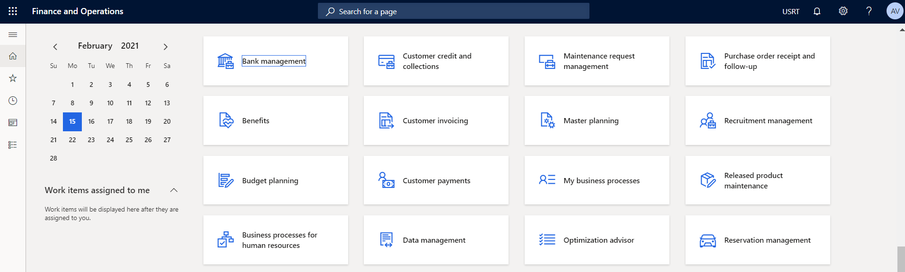
Basic Navigation
Workspaces
D365 Finance and Operations is structured around the concepts of Workspaces.
Workspaces are activity-oriented pages where frequent tasks are stored.
Administrators determine which workspaces users have access to for their specific role.
Notes:
Read and show D365 – Show Procurement Workspaces

Slide 15
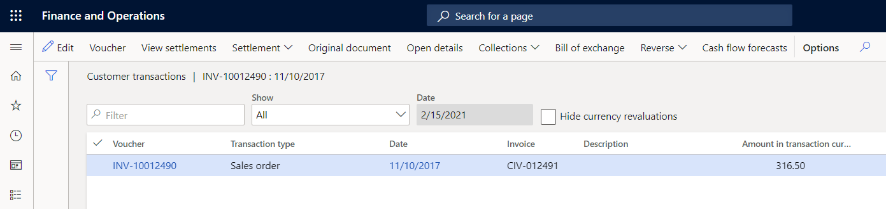
Basic Navigation
Action pane
The Action pane is displayed when navigating to different pages or views within D365 F&O.
This toolbar contains the actions you can take on the specific page you are on.
Notes:
The Command Bar (also called the Action Bar) appears at the top of every page in D365 F&SCM.
It shows the actions available for the page you are on (e.g., New, Edit, Post, Export to Excel).
Options change depending on the form or list page you are viewing.
Show in D365

Slide 16
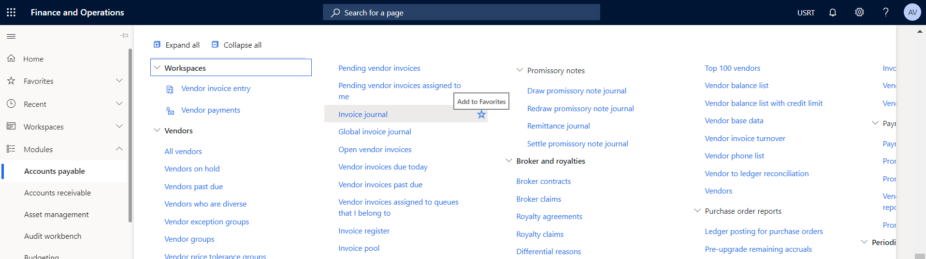
Basic Navigation
Add to Favorites
Favorites are a way to create shortcuts to forms, reports, and inquiries.
Notes:
Notes:
Show in D365 how to add All vendors, All Purchase requisitions and All purchase orders

Slide 17
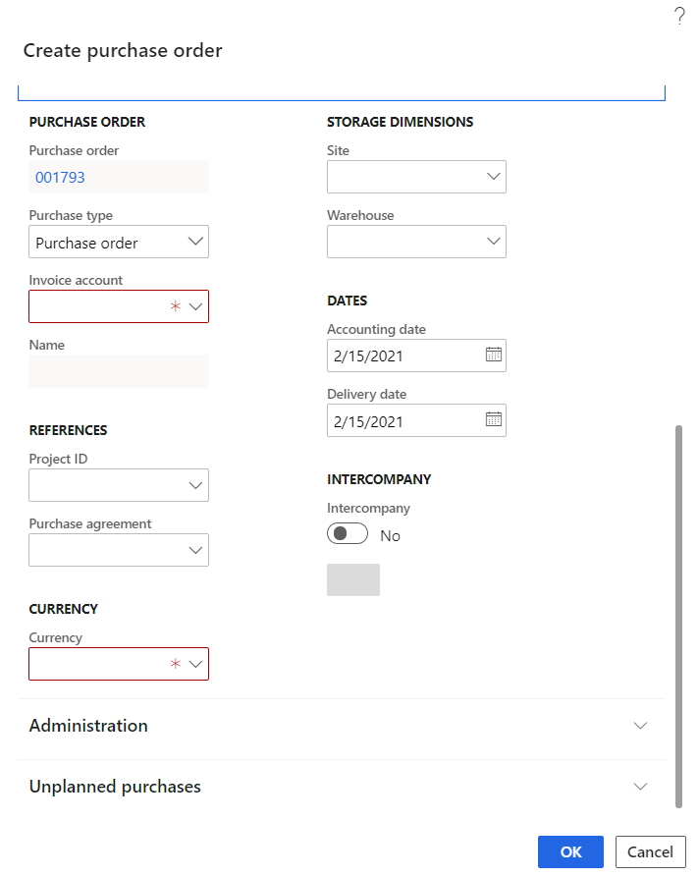
Basic Navigation
Forms & Fields
Throughout D365 F&O forms and fields are available for you to add information and save records.
Required Fields are indicated by a red asterisk (*). These fields must be filled out to save the record.
Many forms also contain FastTab headers that can be collapsed or expanded to easily access or dismiss certain types of information.
Notes:
Read and show D365 that the Selector Arrow and header name is what indicates a FastTab

Slide 18
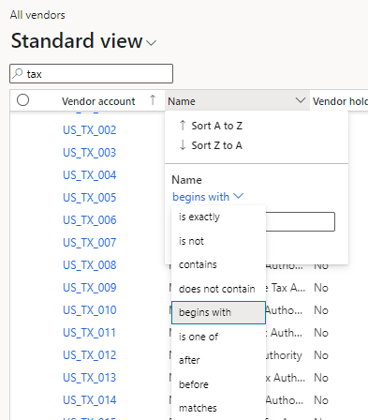
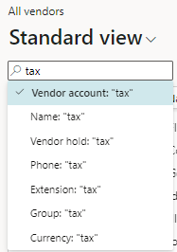
Filtering
Quick Filter
  Filter box to for quick filtering list pages
  Common filter fields are available
  Use can select which field to filter on
  Press down arrow to change filter option
Column Filter
  Filter column heading
  Select filleter criteria such as “begins with” or “contains”
  Filters can be added to multiple columns
Notes:
Show in D365

Slide 19
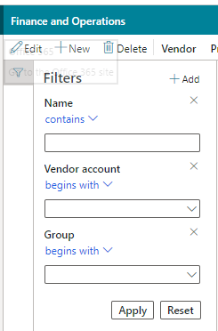
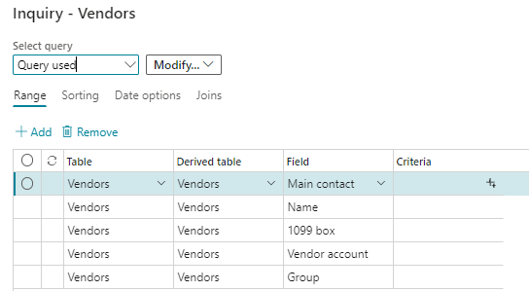
Filtering
Filter Pane
  Applies multiple filter criteria to list page
  Users can select desire fields
Advanced Filter
  Allows users to filter on columns, not on the form; join additional data sources; sort by multiple columns;
Notes:
Advances filter syntax
https://docs.microsoft.com/en-us/dynamics365/fin-ops-core/fin-ops/get-started/advanced-filtering-query-options?toc=%2Fdynamics365%2Ffinance%2Ftoc.json
Show in D365

Slide 20
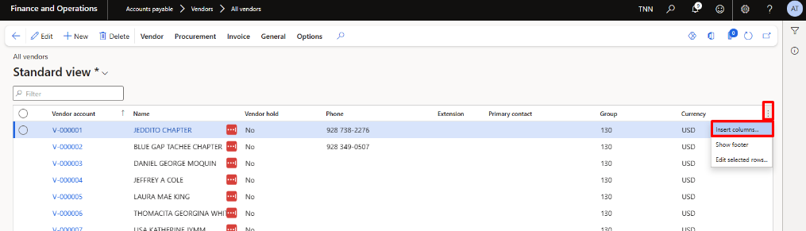
Insert/Hide Columns
Users can insert or hide columns in any list view to personalize their views, showing only the fields that are most relevant to their daily tasks.

Slide 21
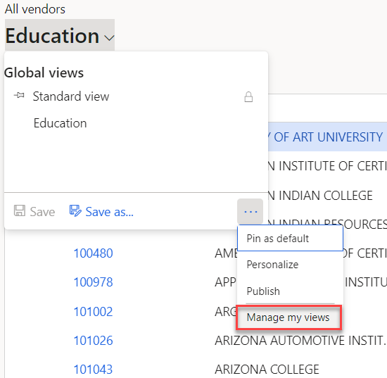
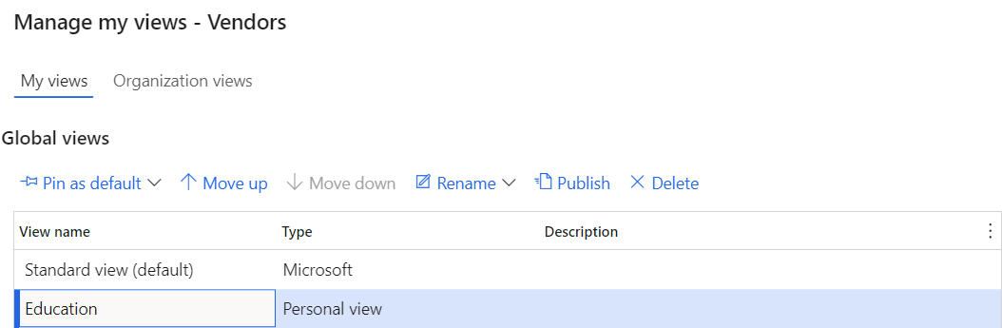
Standard view and Saved Views
Filters can be saved as views for commonly used filter criteria
Views can be set as a default when the page is opened
Views can be updated, renamed, removed and shared with other users
Notes:
Show All vendors how to hide extension, primary contact, and add alternate ID, method of payment and sales tax group

Slide 22

Let’s Practice!
Basic Navigation & Personalization
  Add to Favorites
Create “My Vendors” view

Slide 23
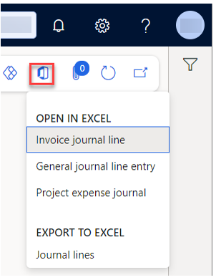
Office Integration
Export to Excel
  The Export to Excel options are static exports of grid data.
  Each one corresponds to a visible grid.
  All the grid data for the current filter is placed into a workbook.
Open in Excel
  The Open in Excel experiences utilize the Excel Add-in to facilitate refresh and publish.
Notes:
Office Integration allows users to connect D365 Finance & Supply Chain Management with Microsoft Excel for easier data review and updates.
https://docs.microsoft.com/en-us/learn/modules/implement-common-integration-features-finance-ops/2-office

Slide 24
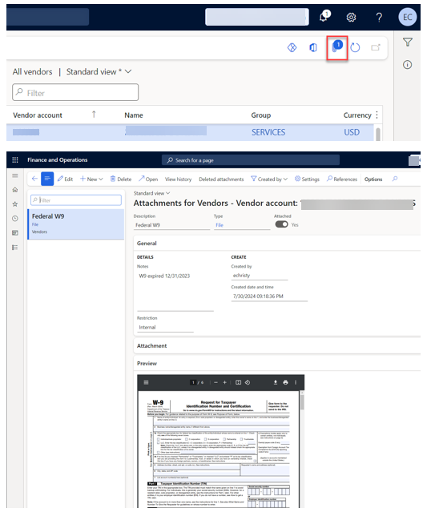
Attachments
Stores file attachments and notes for records
Attachment history can be enabled to maintain an audit of actions related to individual attachments and the user who preformed the action.
  Actions include created, deleted, restored, or moved
Preview documents directly in D365 F&SCM
Attachment recovery can be enabled to restore deleted items.
Notes:
Attachments let you store supporting documents (like quotes, invoices, contracts, or approvals) directly in D365 so everything related to a record stays in one place.
https://docs.microsoft.com/en-us/learn/modules/implement-common-integration-features-finance-ops/4-documents

Slide 25
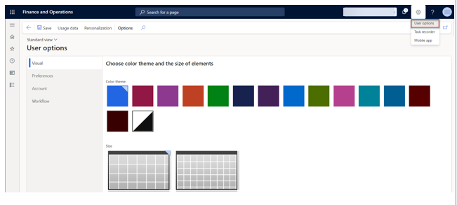
User Options
System wide settings for the current user
Visual – Select a color theme and the default size of elements on pages.
Preferences – Select default values that are used every time that you open the system. Setting include:
  Default company, the initial page, and the default view/edit mode.
  Language, the time zone, and date, time, and number formats. Finally, this tab includes several miscellaneous preferences that vary from release to release.
Account – View or adjust your user name and other account-related options.
Workflow – Select workflow-related options such as notifications and delegations.
Notes:
https://docs.microsoft.com/en-us/dynamics365/fin-ops-core/fin-ops/get-started/personalize-user-experience#system-wide-options-for-the-current-user

Slide 26
Chart of Accounts
Notes:
QRG2

Slide 27
F&SCM Chart of Accounts Structure – QRG2
FMIS
Company | Business Unit | Object Account | Subsidiary
8340 FHWA-NDOT FY23 PA-RFA | K231014 N609 Tuba City ‘23 | 4130 Office Supplies
10 General Fund | 102002 Chinle Judicial District | 3250 Lodging
F&SCM
Main Account (4 chars) | Department (3 chars) | Award (8 chars) | Project (5 chars) | Location (6 chars) | Fund (1 char) | Division (3 chars)
6000 Office Supplies | 307 DEPT OF ROADS - GF | 20205011 20205;693JG42330000V600AZ0028 | TBD | 000000 Not Location specific | 2 Special Revenue | 321 DIVISION OF TRANSPORTATION
5110 Personal Travel Expenses | 173 CHINLE JUDICIAL DISTRICT | NN100000 General Fund | 00000 Not Project specific | 122014 Chinle | 1 | 202 Judicial Branch
Notes:
The Navajo Nation’s existing FMIS chart of accounts differs both structurally and functionally from that of F&SCM. The objective of this design is to ensure a seamless, consistent, and auditable transition to the new chart of accounts, aligning with F&SCM best practices and enabling efficient financial reporting and querying in the new system.

Slide 28
F&SCM Chart of Accounts Structure (cont’d)
Financial Dimension
Main account | Assets = 1xxx Liabilities = 2xxx Equities = 3xxx Revenues = 4xxx Expenses = 5xxx to 8xxx
Department | Same as legacy. However, a reclassification was done since not all legacy departments were true departments (programs). Note: Use specific department number when entering transactions. Value of "000" (non-dept specific) typically used for balance sheet entries or special circumstances.
Award | Awards are the result of Grants from sources that include: - Federal Govt - States including NM, AZ, UT along with other sources - Sihasin Business Units - Some Funds (Permanent, Other Govt, Proprietary, Fiduciary & GASB 34)
Project | All 'C' and 'N' Business Units have been created as Projects. Note: Use 00000 for non-project specific entries
Location | Location values were created based on agency, district, and chapter names found in the Department descriptions. ADDCCC
Fund | Derived from Award. Note: User does not need to specify fund as it will be automatically determined from the award.
Division | Derived from Department. Note: User does not need to specify division as it will be automatically determined from the department.
F&SCM
Notes:
https://docs.microsoft.com/en-us/dynamics365/fin-ops-core/fin-ops/get-started/personalize-user-experience#system-wide-options-for-the-current-user

Slide 29
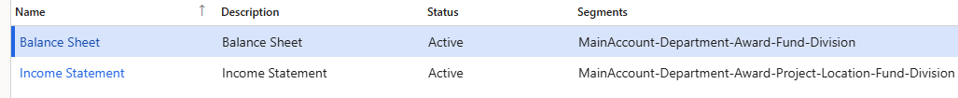
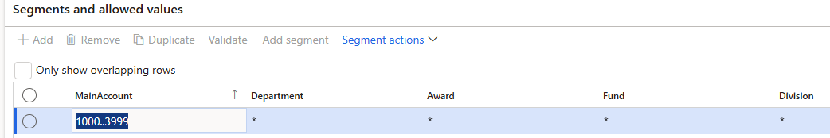
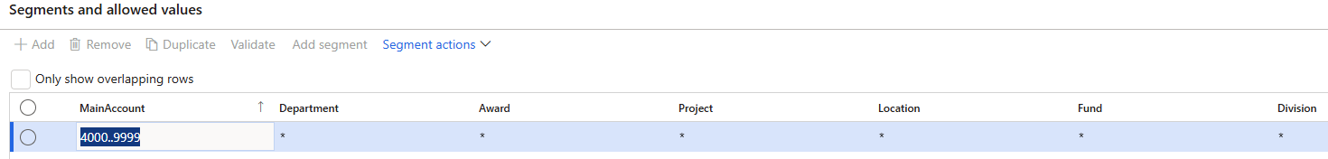
Account Structure
Account structures use the main account and financial dimensions to create a set of rules that determine the order and values used when entering the account number.
You can set up as many account structures as you need for your business.
The account structures are assigned to a company’s ledger setup, so they can be shared.
Notes:
https://docs.microsoft.com/en-us/dynamics365/finance/general-ledger/configure-account-structures

Slide 30
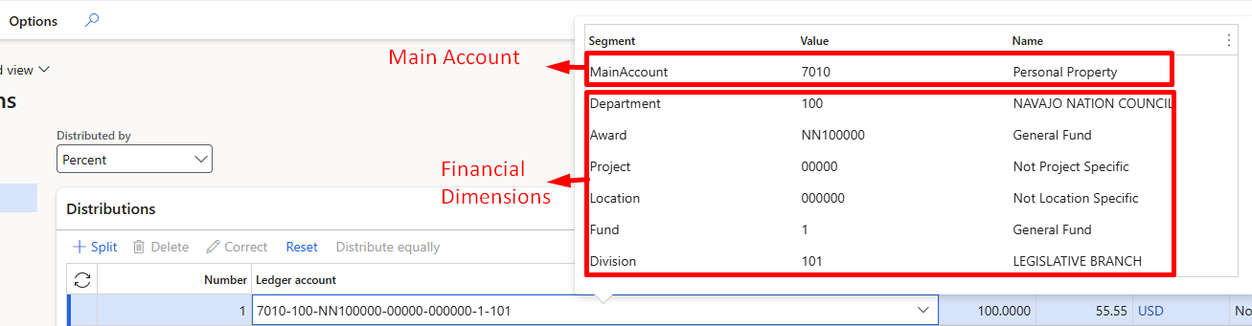
How Posting Works in D365 F&SCM
D365 requires a full account string for every transaction to post to the ledger.
  A full account string = Main Account + Financial Dimensions.
Where the pieces come from:
  Main Account → comes from the Procurement category.
  Financial Dimensions → usually manually entered.

Slide 31
Award
Award Number | Description | Usage
NN100000 | General Fund | For Fund 1 (General Fund)
10000000 to 99999999 | e.g. 20205;DTFH69-18-H-00028 | For Fund 2 (Special Revenue); formerly BU's beginning with K
ARIZ0001 to ARIZ9999 | e.g. ARIZ;YH4-0008-02 | For Arizona awards – Fund 2
NMEX0001 to NMEX9999 | e.g. NMEX;ZD9576 | For New Mexico awards – Fund 2
UTAH0001 to UTAH9999 | e.g. UTAH;UT-230630650 | For Utah awards – Fund 2
OTHR0001 to OTHR9999 | e.g. OTHR;TNC 12152020-01 | For Other awards – Fund 2
NN300000 | NN3;Permanent Fund | For Fund 3 (Permanent Funds); formerly BU's beginning with 3
NN400000 | NN4;Other Governmental Funds | For Fund 4 (Other Govt Funds); formerly BU's beginning with 4
NN500000 | NN5;Proprietary Funds | For Fund 5 (Proprietary Funds); formerly BU's beginning with 5, 6, 8 & 9
NN600000 | NN6;Fiduciary | For Fund 6 (Fiduciary Funds); formerly BU's beginning with 7
NN700000 | NN7;Sihasin | For Fund 7 (Sihasin Funds)
NN900000 | NN9;GASB 34 | For Fund 9 (GASB 34 Funds)
Notes:
Continue until Slide 35

Slide 32
Procurement and Sourcing

Slide 33
Procurement & Sourcing
Vendor records are created and maintained in Procurement module and in the Accounts Payable Module.
The Procurement module is used to manage the relationships of vendors and categories and items.
Requisitions will typically be the starting point for a procurement transaction progressing through to the point of the purchase order and the receipt of goods.

Slide 34
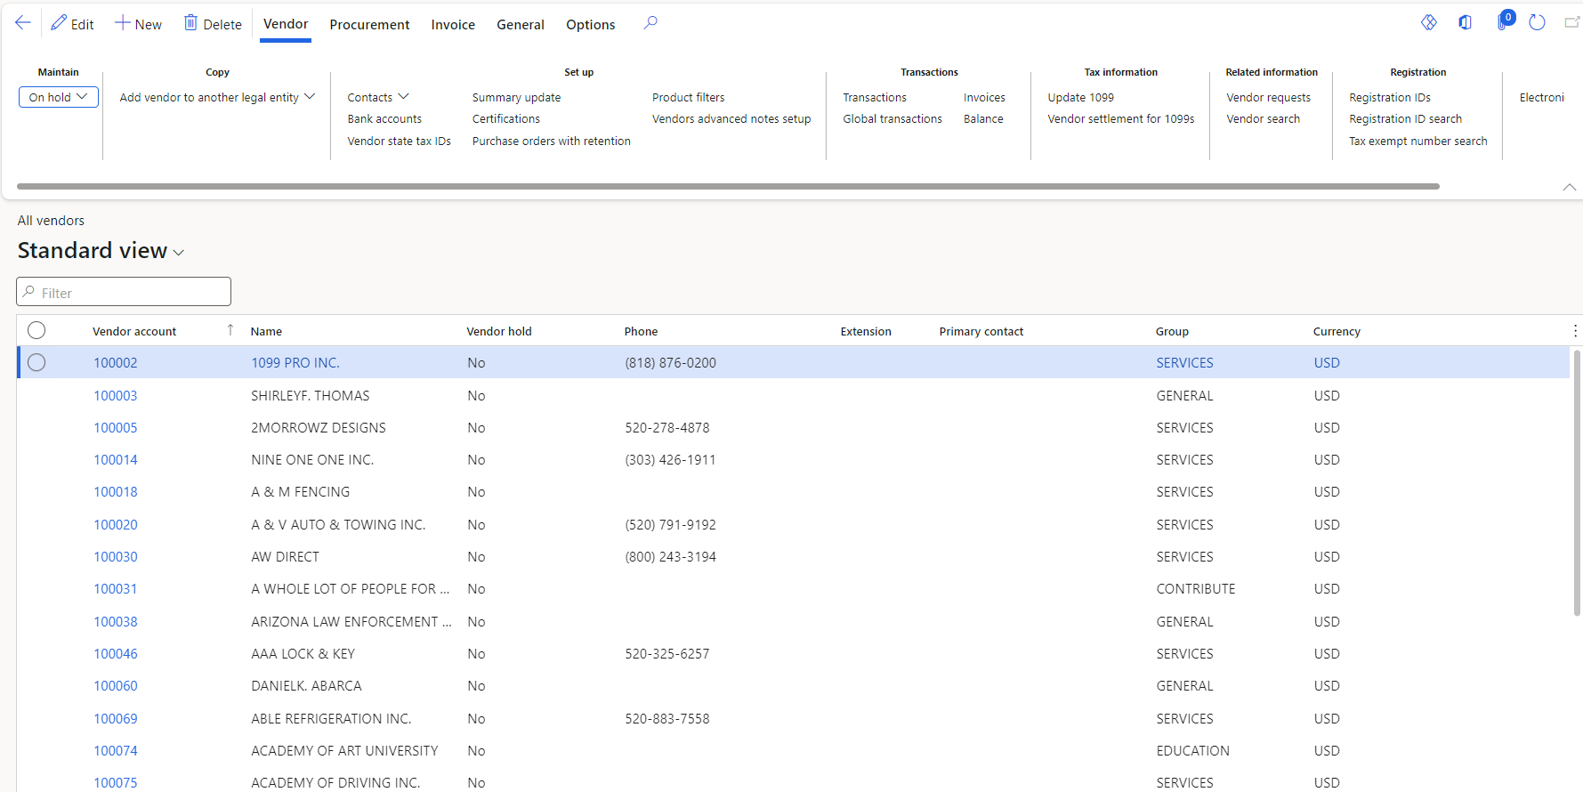
Vendor Information (Inquiry Only)
Vendor records are created and maintained in Procurement module and in the Accounts Payable Module.
Vendor record includes:
  Vendor number & name
  Contact information
  Payment terms
  Method of payment
  Bank information
Vendor Inquiries:
  View Purchase Orders and receipts (outstanding invoices)
Notes:
Show in D365

Slide 35
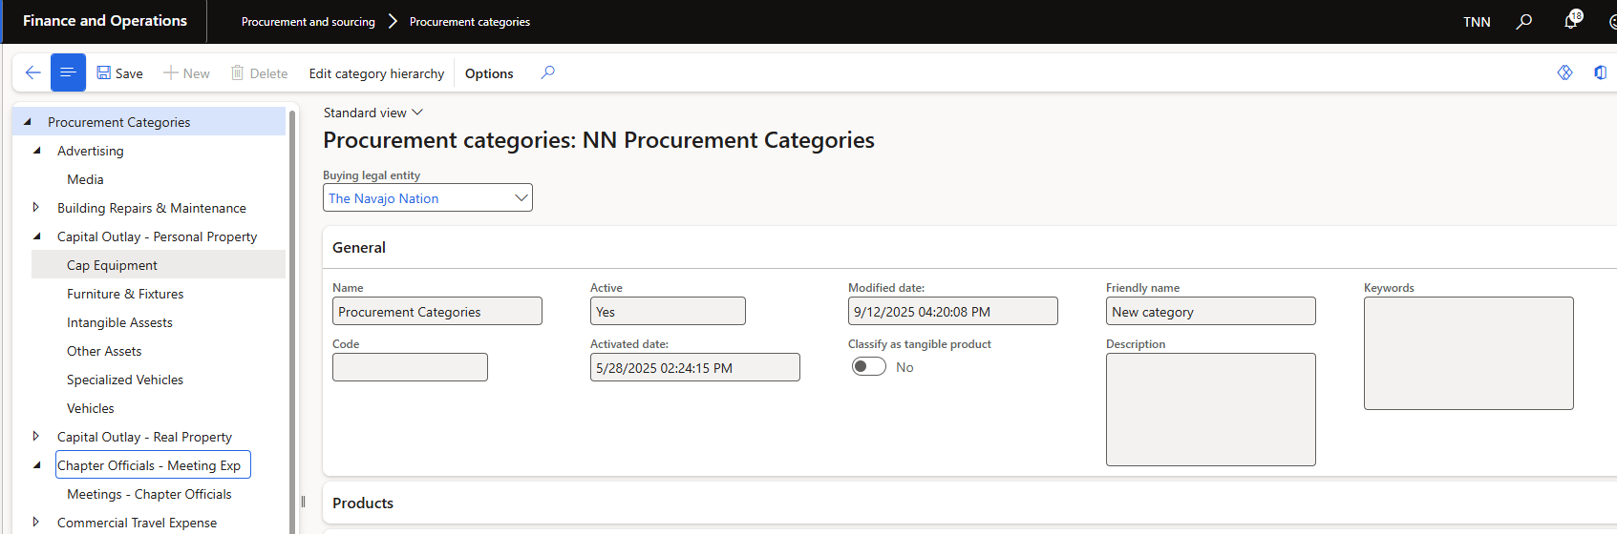
Procurement Categories
Procurement categories are used to classify goods and services purchased through requisitions and purchase orders. They provide structure for approvals, reporting, and accounting. Inventory Posting Profiles link procurement categories to main accounts

Slide 36
NN purchasing policies
  Procurement categories are allowed for all vendors.
  Category matching policy: Three-way matching
  Accrue purchase expenses on receipt.
  Business reason is required.
  Requisition purpose rules
  Approved purchase requisition automatically creates a purchase order.

Slide 37
Business Reason
The Business Reason provides justification for the purchase and ensures compliance with policy.
Most importantly, the business reason determines which approval workflow process the requisition follows.
Without a valid business reason, the requisition cannot be submitted for approval.
Type | Description | Examples
General Purchases (Goods/Supplies) | Buying physical goods and materials needed to run operations. | Office supplies, groceries, equipment, fuel.
Contracts | Paying for services provided by an external vendor under a contract. This includes Leases. | Janitorial contracts, IT services, consultants, training providers, Leases.
Subrecipient Agreement | Passing funds to another entity that helps carry out a program on your behalf. They manage program decisions and compliance. | Community capital funding, agencies running federally funded programs, enterprise allocations.
Direct Payments | Allocations or benefits already approved by council or law. Not procurement, not a contract, not a subrecipient. | Veterans’ benefits, scholarships, utilities, housing assistance.

Slide 38
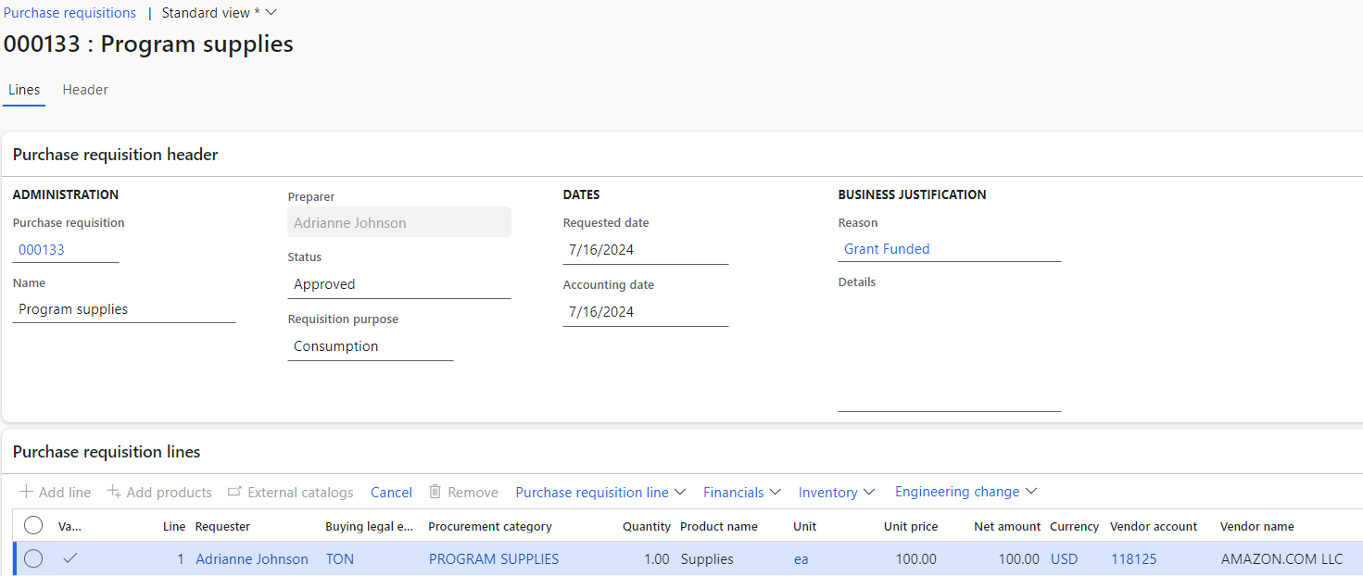
Purchase Requisitions – QRG3
A purchase requisition is an internal document that authorizes the Purchasing department to buy items or services.
After a purchase requisition is approved via workflow, it will generate a purchase order.
Purchase orders are the external documents that the Purchasing department submits to vendors.
The requestor for a requisition must be an active worker within D365.
Notes:
Continue next slide …

Slide 39
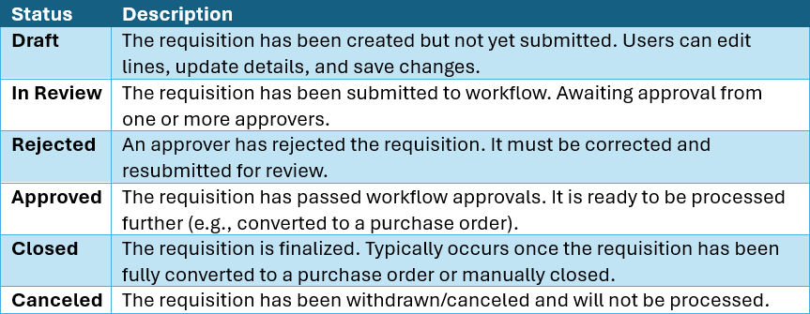
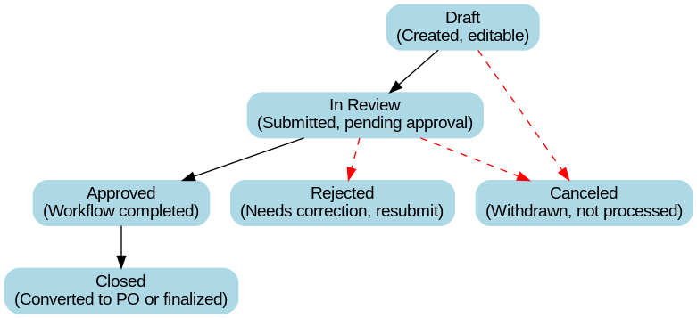
Purchase requisitions statuses
Notes:
Show in D365

Slide 40
WORKFLOW ORIGINATOR CAPABILITIES
💡 Use this when you need to make changes. | 💡 Use this to track progress or see who approved.
Recall from Workflow | Review Workflow History
1- Open the requisition. | 1- Open the requisition.
2- Go to Action Pane > Workflow > Recall. | 2- Go to Action Pane > Workflow > Workflow history.
Notes:
Enter Purchase requisitions:
1- regular purchases – P3
2- Blanket order – groceries P4
3- Service contract. P5
Notification will be received in the action center.
Show Open requisitions prepared by me

Slide 41
Let’s Practice!
Creating a Purchase Requisition– Purchases
Creating a Purchase Requisition - Blanket order
Creating a Purchase Requisition - Service contracts

Slide 42
Procurement approval functions– QRG4
The Purchase Requisition workflow in D365 F&SCM routes requisitions through several approval stages depending on the Business Reason and purchase threshold.
In most cases, the Procurement review is always the first step, followed by buyer assignment and approvals.
Notes:
Next slide

Slide 43
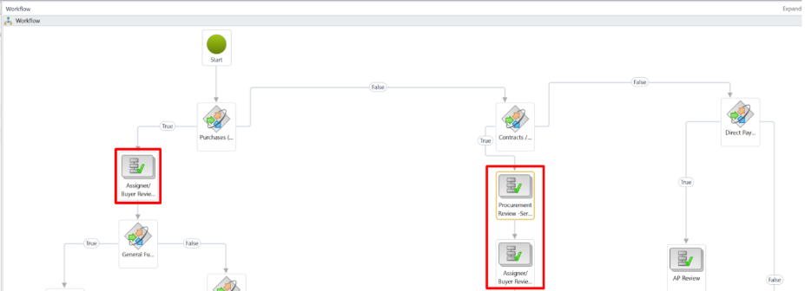
In the workflow diagram, red squares highlight the steps performed by the Procurement Department. These include:
Initial review,
buyer assignment/delegation, and
Procurement approvals.
Notes:
Next to read details on each

Slide 44
Key Workflow Highlights
Buyer Assignment → Delegate to the correct buyer and record their name in the header. This workflow stage includes two parts:
  The assignment of the requisition to a Buyer
  The procurement/approval work by that Buyer.
Procurement Review → Verify business reason, attachments, and vendor details.
Final Buyer Approval → Confirms buyer and procurement actions before PO creation.

Slide 45
Let’s Practice!
Select roles:
  Requisition assigner
  Procurement Review
  Buyer
Approving a Purchase Requisition – Buyer Assignment (Delegation)
Notes:
Login to Chrome as AIT1 to show the RFQ – P6

Slide 46
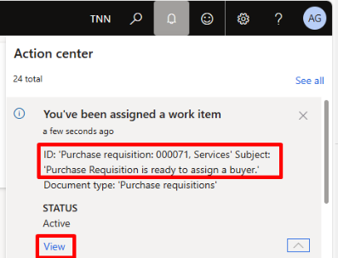
Purchase Requisitions- Approver Roles – QRG5
When a requisition is submitted for approval, the approver will be notified in three places:
  Action Center – if enabled for your user (see instructions below), notifications appear in the top right of the screen.
  Work items assigned to me – on your D365 home page, showing pending tasks.
  Emails – to be configured in the future.

Slide 47
Take Action in Workflow
Approve → Moves the requisition to the next step in the workflow.
Reject → Stops the process and sends it back to the originator.
Request Change → Returns the requisition for updates before resubmission.
Delegate → Assigns the approval task to another authorized approver.

Slide 48
Let’s Practice!
Approving a Purchase Requisition

Slide 49
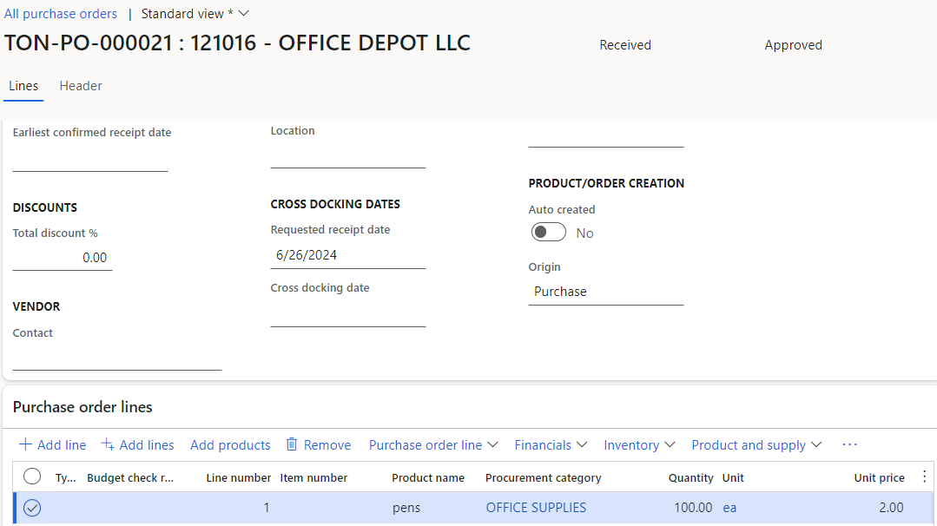
Purchase Orders – QRG6
Purchase Orders (POs) are automatically generated once a Purchase Requisition (PR) has been fully approved and closed. This ensures that all required department approvals are completed before the PO is created.
The purchase order when confirmed represents the contract between the client and the vendor.
Once fully invoiced, the purchase order should be finalized.
The PO inherits details from the requisition, no changes to line items (quantities, prices, accounts) should be entered. Instead, Procurement’s role is:
Review the PO,
Assign the Orderer,
Verify the Delivery address, and
Confirm the order for processing.
Notes:
Next slide

Slide 50
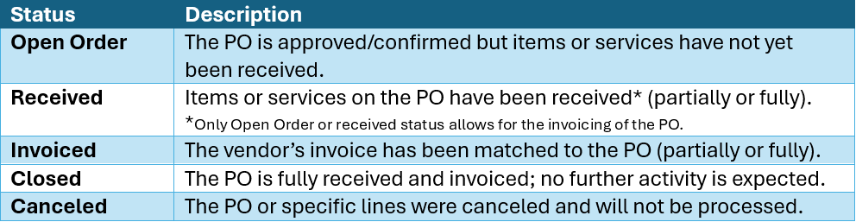
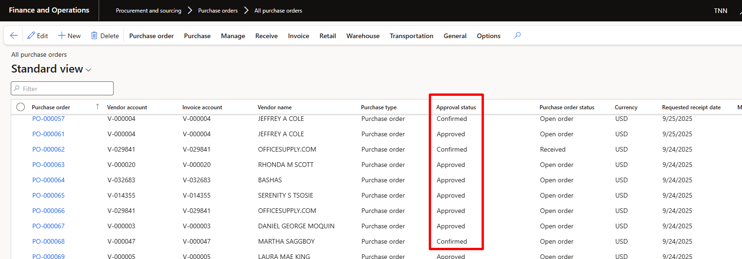
Purchase order status
Notes:
D365 – Show PO:
1- from requisition
2- All Purchase orders
3- Process to finalize a purchase order

Slide 51
Let’s Practice!
Purchase Order confirmation

Slide 52
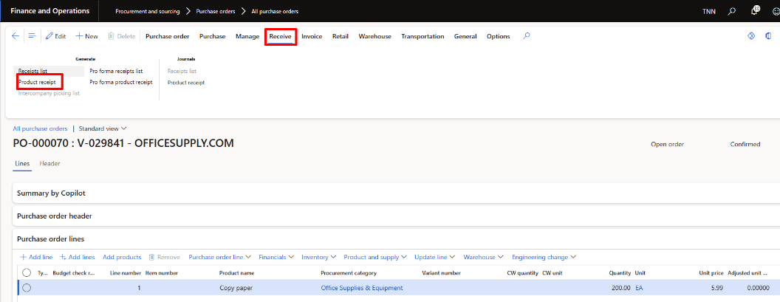
Product Receipt
A Product Receipt in D365 F&SCM is the process of recording that goods or services ordered on a Purchase Order have been received:
  It confirms delivery,
  It updates inventory or expense accounts, and
  It allows the vendor invoice to be matched against what was actually received.
The PO status changes to Received once fully received.
If only a partial quantity is received, the PO status remains Open order until all items are received.

Slide 53
Let’s Practice!
Product receipt
  Fully receive a Purchase Order
  Partially receive a Purchase Order

Slide 54
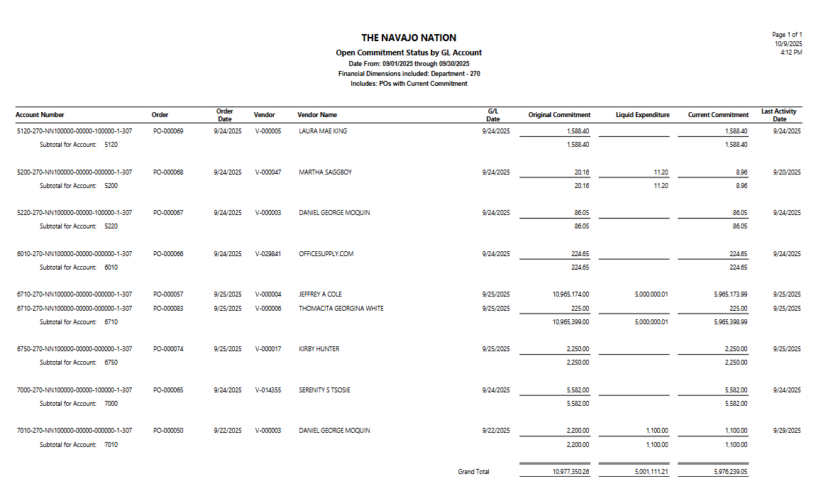
INQUIRIES & REPORTS
Open Commitment Status by GL Account Report
It provides visibility into Purchase Orders and related commitments tied to specific General Ledger accounts, helping users reconcile financial activity and monitor spending.

Slide 55
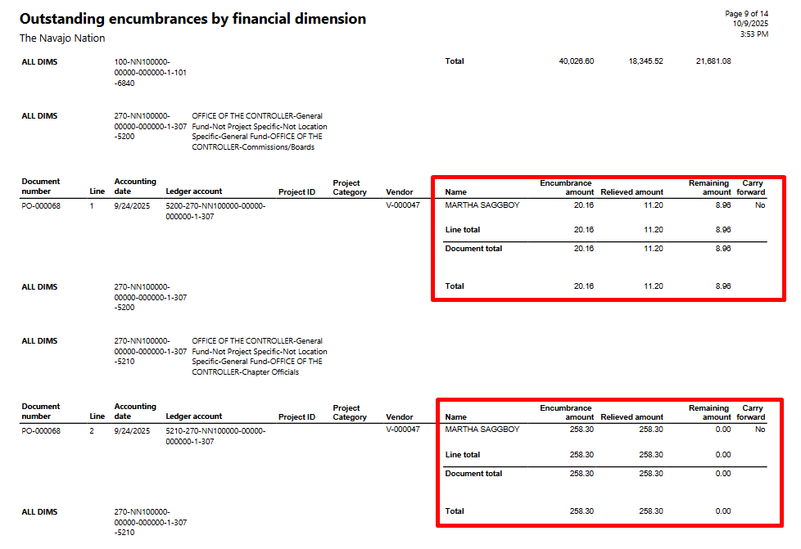
INQUIRIES & REPORTS
Outstanding encumbrances
It provides visibility into open encumbrances — amounts that have been committed to purchase orders but not yet invoiced or liquidated.
  Identify outstanding POs that may need to be closed or reviewed.
  Ensure accurate financial reporting at month-end or year-end.
  It helps finance and procurement teams
  Monitor remaining obligations against budgets.

Slide 56
End User Training - Keys to Success
Start planning as an individual
Focus on the basics
Prepare training materials early
Practice your presentations

Slide 57
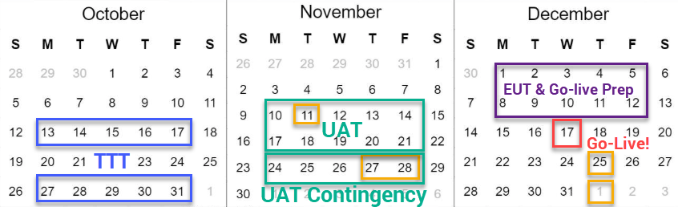
After Power User Training
Immediately after training
  AIT
    Prioritize issues found during training with NN
    Address high priority issues
    Update QRGs as needed
    Refresh environment for UAT
  NN
    End User Training prep
    UAT Test Scripts
UAT: 11/10/25 – 11/21/25
UAT Contingency: 11/24 – 11/28
End User Training: 12/1 – 12/12
Go-live Readiness: 12/1 – 12/12

Slide 58
Questions?

Slide 59
Thank You!

